Slide 1

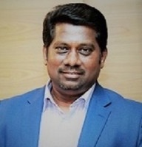
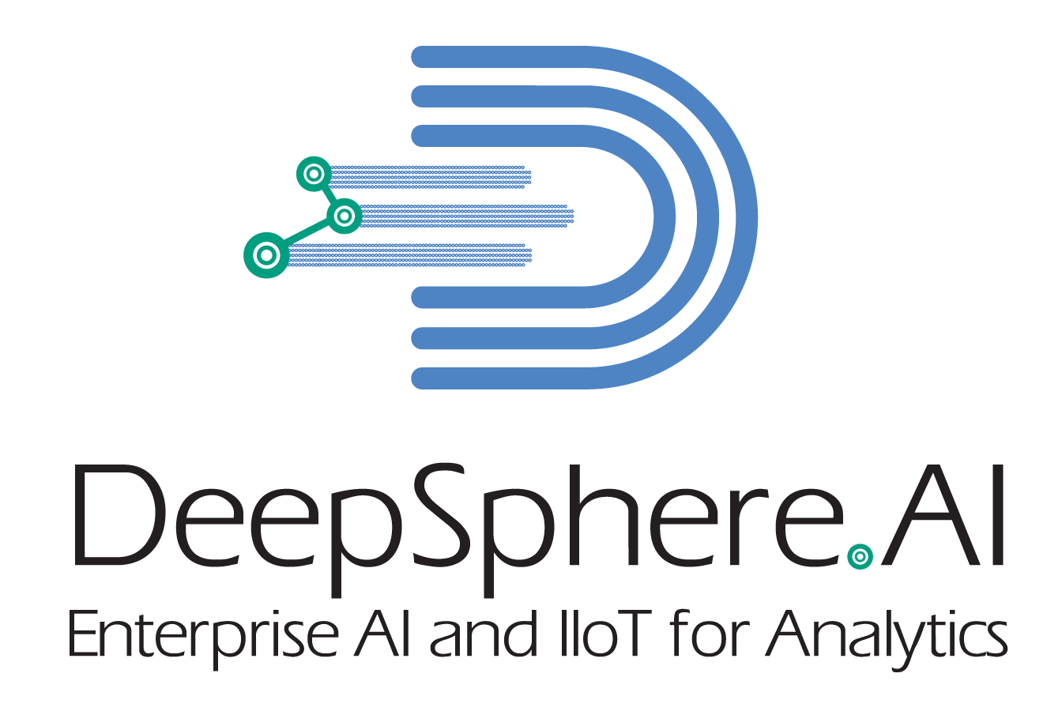
Jothi Periasamy
Chief AI Architect
DeepSphere.AI
Chief Data Scientist & Instructor
University of California
Silicon Valley, CA, USA
17+ years of management consulting and end-to-end AI (ML, DL, RPA, NLP) experience with Deloitte, E&Y, and KPMG
Over 50+ clients across industries: Health, Energy, Oil & Gas, Public Services
Teaches AI at MIT – Head of AI, Architect at Experfy, Harvard Innovation Lab
Co-innovates industry solution along with SAP America
Published on finance, AI, big data, IIoT, Cloud, and SAP Appliances
Delivered many research projects on market for AI enterprise services
Globally recognized as a keynote speaker. Spoke at 50 conferences
Recently invited by Prime Minister office of Dubai, Malaysia, and Montreal
Stanford alumni
Artificial Intelligence Learning Facilitator
MIT CSAIL & MIT Sloan,
Boston, MA, USA
Board of Studies(BoS) for Next Level Learning
SRM University
India
Head of Artificial Intelligence
Experfy (Harvard Innovation Lab),
Boston, MA, USA
Academic Council for AI
Universiti Tenaga Nasional University
Selangor, Malaysia
©DeepSphere.AI | 2021 | Confidential & Proprietary

